Slide 1
Getting Started
Download the Lecture 9 Website folder from Funda
Open the web site folder in VSCode
View the Home page in the Browser
Click on the button – what happens?
Click on the options available in the footer – what happens?

Slide 2
Using jQuery for interactivity and formatting
Lecturer:
Ms Isabelle Taljaard

Slide 3
JavaScript for formatting
jQuery - library of JavaScript functions
Two ways to access
Download and use local version
Online URL, e.g. http://code.jquery.com/jquery.js
Features
Select and manipulate HTML
Manipulate CSS
JavaScript Effects and animations
HTML DOM traversal and modification

Slide 4

How to use jQuery (Step 1)
In your HTML file(s):
Add script tag to <body> section – after last html instruction, before your JavaScript file, specify the correct source (URL)
Local downloaded version
Online URL
Add a second script tag (link to external js file) – below the link to the jQuery library
Notes:
JavaScript for programming logic
jQuery for effects and formatting

Slide 5
How to use jQuery (Step 2)
In your external js file:
Write jQuery instructions using the available selectors and events
(this is where you say how you are using the library of JavaScript functions)

Slide 6
Getting Started
Download the Lecture 9 Website folder from Funda
Open the web site folder in Visual studio or VSCode
View the Home page in the Browser
Click on the button – what happens?
Click on the options available in the footer – what happens?

Slide 7
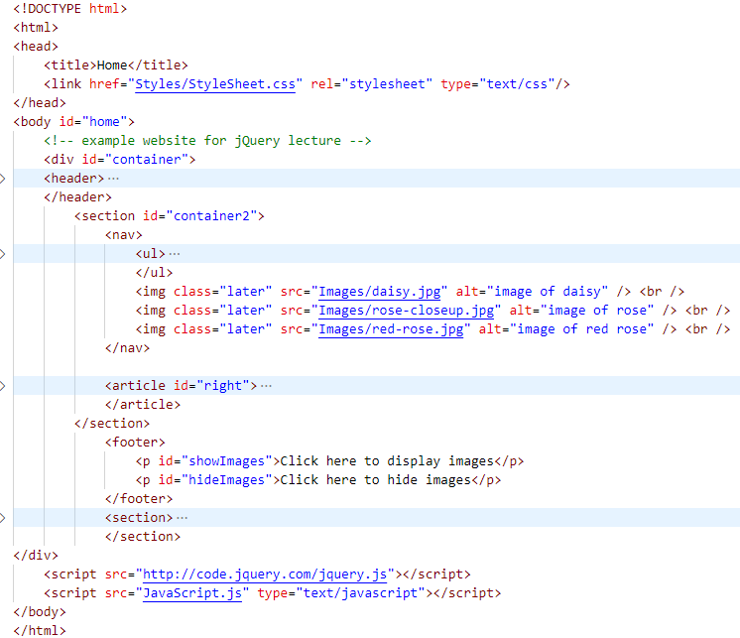
Investigate the files - HTML
Two scripts tags just above the </body> tag
Use of class later
Use of id’s in footer

Slide 8
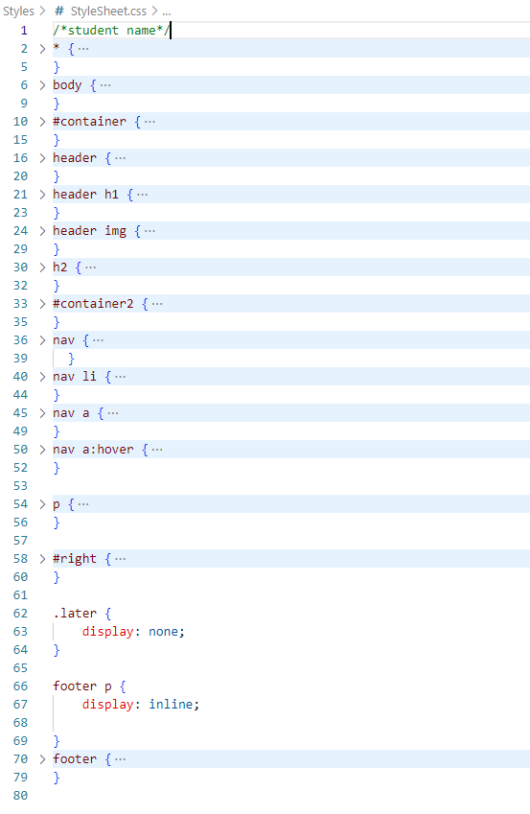
Investigate the files - CSS
Standard formatting that the website loads with
Usual tag formatting
Class later initially hidden (lines 62 – 64)
Two paragraphs in footer displayed next to one another

Slide 9
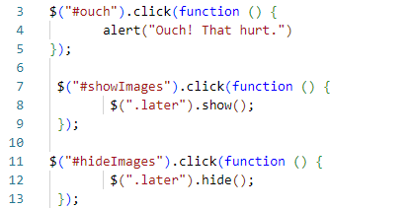
Investigate the files - JS
Three sets of code
All three linked to a click event
When the user clicks on something, a function call is made

Slide 10

A Closer Look
$("#ouch") selects the element with ID ouch
.click() binds a click event to selected element
The function executes when the click event is fired – and the alert is displayed
Display an alert when the button with ID = ouch is clicked

Slide 11

jQuery Syntax
$(selector).event(function() {$(selector).action();});
$ to define/access jQuery
A (selector) to query (or find) the HTML elements
The event which will trigger the execution of the function
Another selector to find the HTML elements on which the function will be applied
A jQuery action() to be performed on the elements / applied to the elements
It is possible to apply the action to the same element(s) on which the event was performed
But not the only way, e.g. is possible to click on one element, to have something happen to another element

Slide 12


A Closer Look
$("#showImages") finds the element with ID showImages
.click() binds a click event to located element
The function executes when the click event is fired – and all elements with class later is displayed
Displays all the elements with the later class, when the text with ID= showImages clicked

Slide 13
jQuery Events
Mouse events
Also keyboard, form and document events
Event Method | Description
$(selector).click(function) | Invokes a function when the selected elements are clicked
$(selector).dblclick(function) | Invokes a function when the selected elements are double-clicked
$(selector).mouseover(function) | Invokes a function when the mouse is over the selected elements
For a full jQuery event reference, see jQuery Events Reference -
https://www.w3schools.com/jquery/jquery_ref_events.asp

Slide 14
jQuery Selectors
For a full reference please see jQuery Selectors Reference -
https://www.w3schools.com/jquery/jquery_ref_selectors.asp
Syntax | Description
$(this) | Current HTML element
$("p") | All <p> elements
$("p.intro") | All <p> elements with class="intro"
$(".intro") | All elements with class="intro"
$("#intro") | The first element with id="intro"
$(“tr:even") | All even <tr> elements
$("ul li:first") | The first <li> element of each <ul>
$("[href]") | All elements with an href attribute
$("div#intro .head") | All elements with class="head" inside a <div> element with id="intro"

Slide 15
Comparison: JavaScript vs jQuery
In your JavaScript self study activities, you might have found that JavaScript is often used for interactive web pages / formatting
But
We use JavaScript for programming logic
And
jQuery for interactive web pages/formatting
Why? – Consider the following task
Display a message whenever any link is clicked
(remember that a web page often contains many links)

Slide 16
Comparison: JavaScript vs jQuery
Task: Display a message whenever any link is clicked
Using JavaScript
Need onclick event for every <a>
Using jQuery
Specify in js code that a message must be displayed
Once again (as with HTML and CSS) this also helps with
Separation of structure (HTML) and behavior(JS)
<a href="#" onclick="alert(‘You clicked a link!')">Link</a>
$("a").click(function(){
alert("You clicked a link!");
});

Slide 17
jQuery Effects
Adding some interactivity to your website
Function | Description
$(selector).hide() | Hide selected elements
$(selector).show() | Show selected elements
$(selector).toggle() | Toggle (between hide and show) selected elements
$(selector).slideDown() | Slide-down (show) selected elements
$(selector).slideUp() | Slide-up (hide) selected elements
$(selector).slideToggle() | Toggle slide-up and slide-down of selected elements
$(selector).fadeIn() | Fade in selected elements
$(selector).fadeOut() | Fade out selected elements
$(selector).fadeTo() | Fade out selected elements to a given opacity
$(selector).fadeToggle() | Toggle between fade in and fade out
Notes:
Check and add something about parameters for these methods – especially check fadeTo – it seems to need a speed parameter before the opacity value

Slide 18
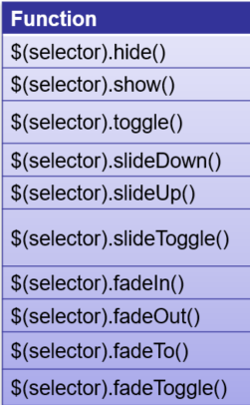
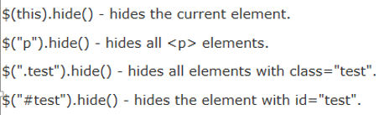
Examples
Just showing .hide() here, but all the effects can be used in this way

Slide 19
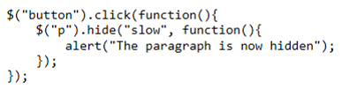
Using optional Parameters
$(selector).hide(speed, callback)
$(selector).show(speed, callback)
Speed: “slow”, “fast” or value in milliseconds
Callback: function to be executed after the effect has executed
When the user clicks on the button, the paragraph will slowly be hidden, and then an alert will be displayed

Slide 20
Manipulating CSS
CSS Properties | Description
$(selector).css(propertyName) | Get the style property value of the selected element
$(selector).css(propertyName,value) | Set the value of one style property for selected elements
$(selector).css({properties}) | Set multiple style properties for selected elements
$(selector).addClass(class) | Apply style class to the selected elements
For a full jQuery CSS reference, please see jQuery HTML/CSS Methods Reference
https://www.w3schools.com/jquery/jquery_ref_html.asp

Slide 21
Setting multiple css properties
css({“propertyname”:”value”,”propertyname”:”value”,…});

Slide 22
Manipulating HTML
Function | Description
$(selector).html(content) | Changes the (inner) HTML of selected elements
$(selector).append(content) | Appends content to the (inner) HTML of selected elements
$(selector).after(content) | Adds HTML after selected elements (not changing the innerHTML of existing elements, but adding additional HTML)
For a full jQuery CSS reference, please see jQuery HTML/CSS Methods Reference
https://www.w3schools.com/jquery/jquery_ref_html.asp

Slide 23

Chaining jQuery commands
Equivalent to
Speed in milliseconds

Slide 24
Narrow the search for elements
Get the first or last element of a specific kind
jQuery methods first() and last()
Select the first <p> element
Selects the last <p> element
Then apply required changes
$("p").first();
$("p").last();
$("p").first().css("color", "yellow");

Slide 25
Resources
http://jquery.com/
http://www.w3schools.com/jquery

